Slide 1
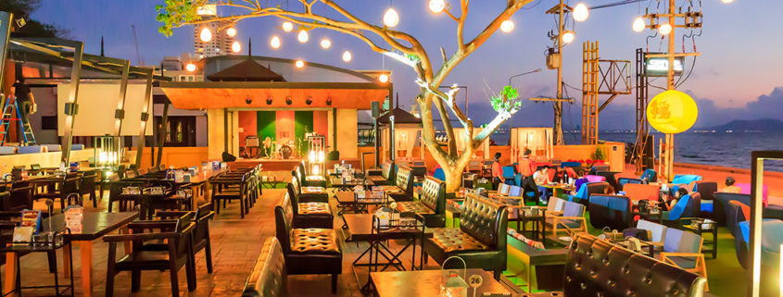
Bangalore’s Best Restaurants
Eat well, Live Well, Be Well
From
Lathishkumar K M

Slide 2
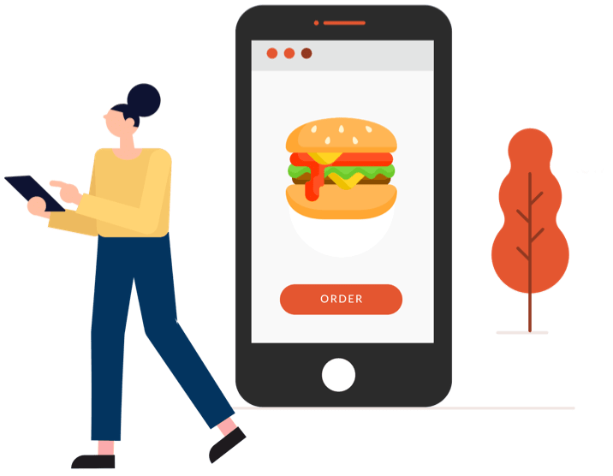
About Zomato Orders
Zomato is an Indian multinational restaurant aggregator and food delivery company.
In Bangalore, almost all restaurants are registered to accept online orders on Zomato.
Providing food straight to customer’s homes with just a few clicks.
Providing restaurant listings, reviews and dine-out services to customers in all places in Bangalore.

Slide 3

Problem Statement
In the vibrant city of Bangalore, the restaurant industry is thriving, offering diverse dining experiences. However, selecting the right location for a restaurant is a complex decision that significantly impacts its success. In this project, we address the challenge of identifying the most favorable restaurant locations in Bangalore.

Slide 4
Attributes
1. Url contains the url of the restaurant in the zomato website
2. Address contains the address of the restaurant in Bengaluru
3. Name contains the name of the restaurant
4. Online order whether online ordering is available in the restaurant or not
5. Book_table table book option available or not
6. Rate contains the overall rating of the restaurant out of 5
7. Votes contains total number of rating for the restaurant as of the above mentioned date
8. Phone contains the phone number of the restaurant
9. Location contains the neighborhood in which the restaurant is located
10. rest_type restaurant type

Slide 5
Attributes
11. dish_liked dishes people liked in the restaurant
12. cuisines food styles, separated by comma
13. approx_cost(for two people) contains the approximate cost for meal for two people
14. reviews_list list of tuples containing reviews for the restaurant, each tuple
15. menu_item contains list of menus available in the restaurant
16. listed_in(type) type of meal
17. listed_in(city) contains the neighborhood in which the restaurant is listed

Slide 6
Methodology
Before cleaning & dropping data
After cleaning & dropping data
Shape
Rows - 51717
Columns - 17
Shape
Rows - 35011
Columns - 10

Slide 7
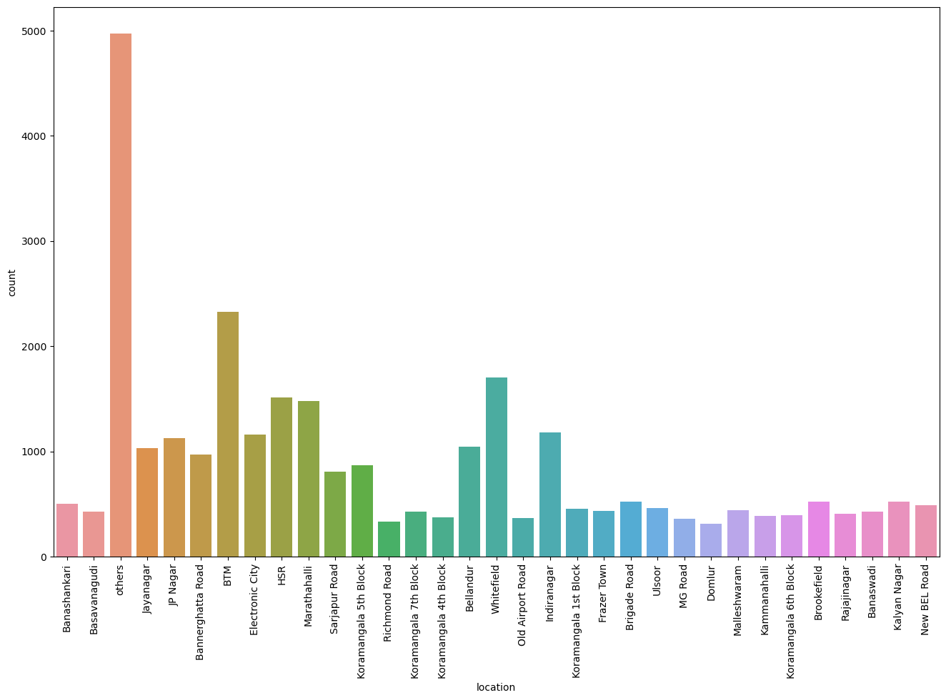
List of Restaurants in a Specific Location
"BTM" exhibits the highest number of restaurants (2324).
“Domlur” exhibits the lowest number of restaurants (306).

Slide 8
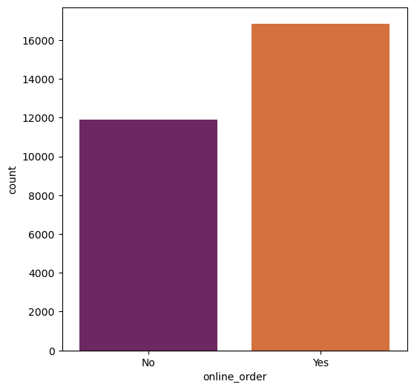
Online orders
The graph below you can understand that we have almost 18,000 Restaurants in Bangalore that Accepts online orders through Zomato and Almost of 11,800 are not accepting any online orders through Zomato

Slide 9
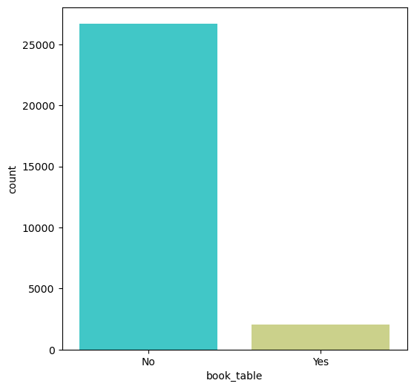
Online Booking Table
Booking a table from the comfort of your homes is a great customer experience as it increases your chances of a confirmed.
The graph below you can understand that we have almost 25,000 Restaurants in Bangalore that Not Accepts booking table and Almost of 1500 are Accepting any online booking table through Zomato

Slide 10
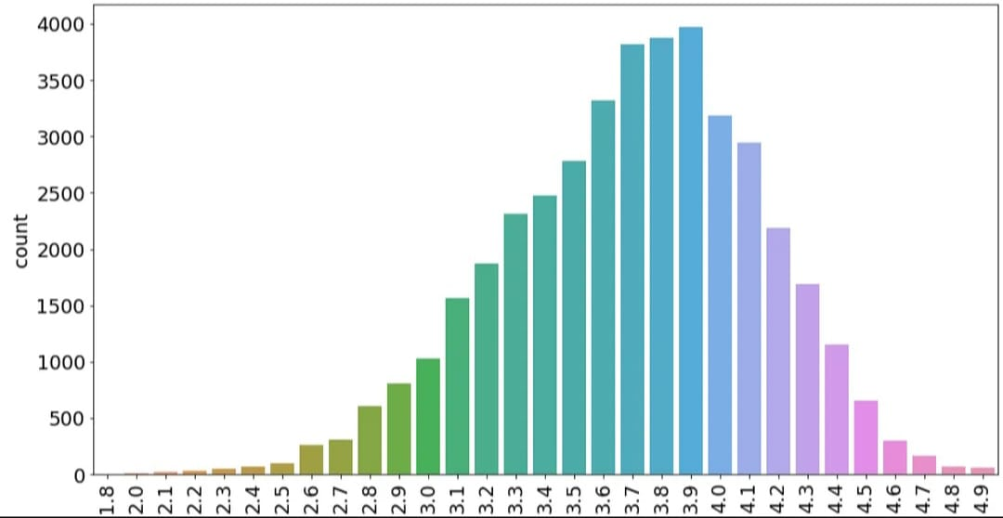
Ratings
After Analysing we come to know is 3.9 for all the Restaurants overall gained which means that are good to order or to eat from all the Restaurants in Bangalore.

Slide 11
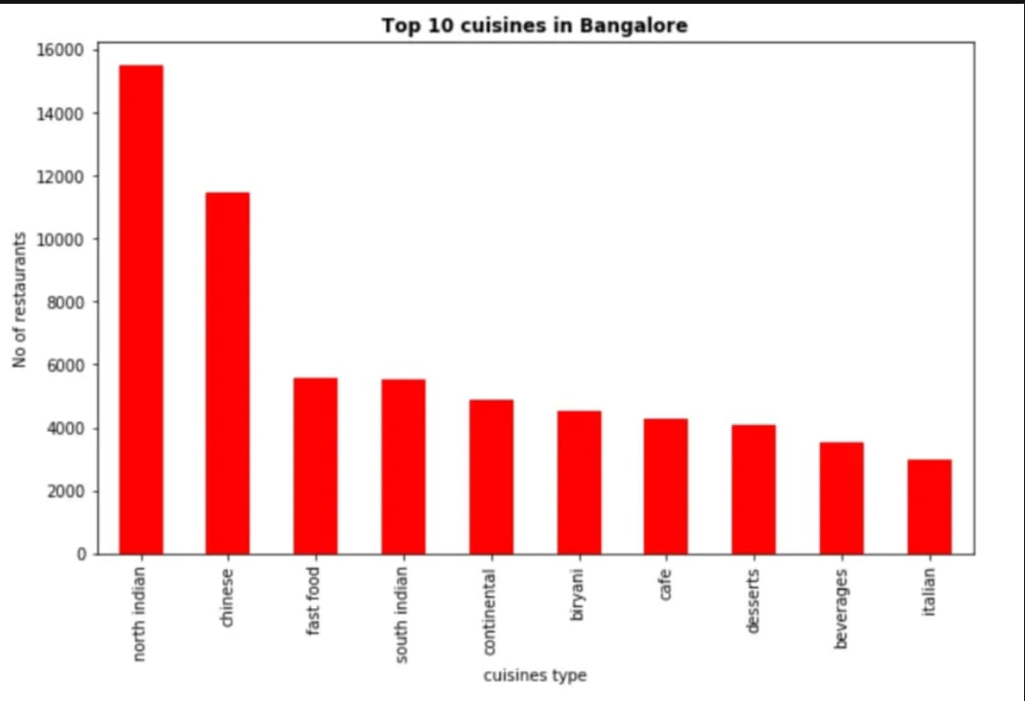
Cuisines
We have several cuisines made by Restaurants in Bangalore for the people over there as they would be from different parts of the country and from different cultures.
Top 1 cuisines is North Indian type have nearly 15750 Number of Restaurants.

Slide 12
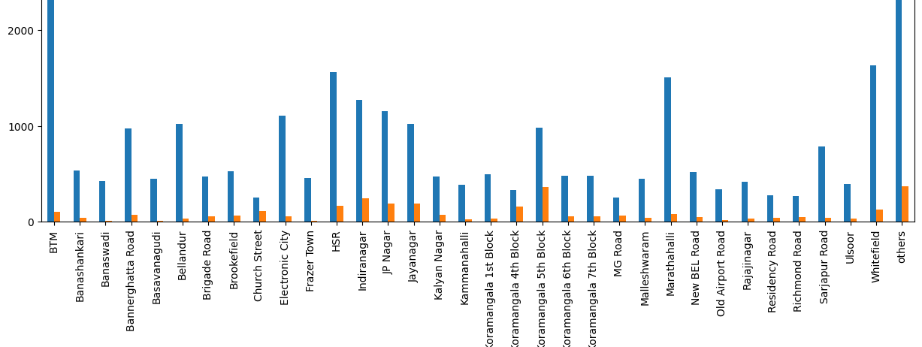
Book Table Facility, Location Wise
"Koramangala 5th block," table bookings are notably high, while "BTM" displays the least occurrence of such reservations.

Slide 13
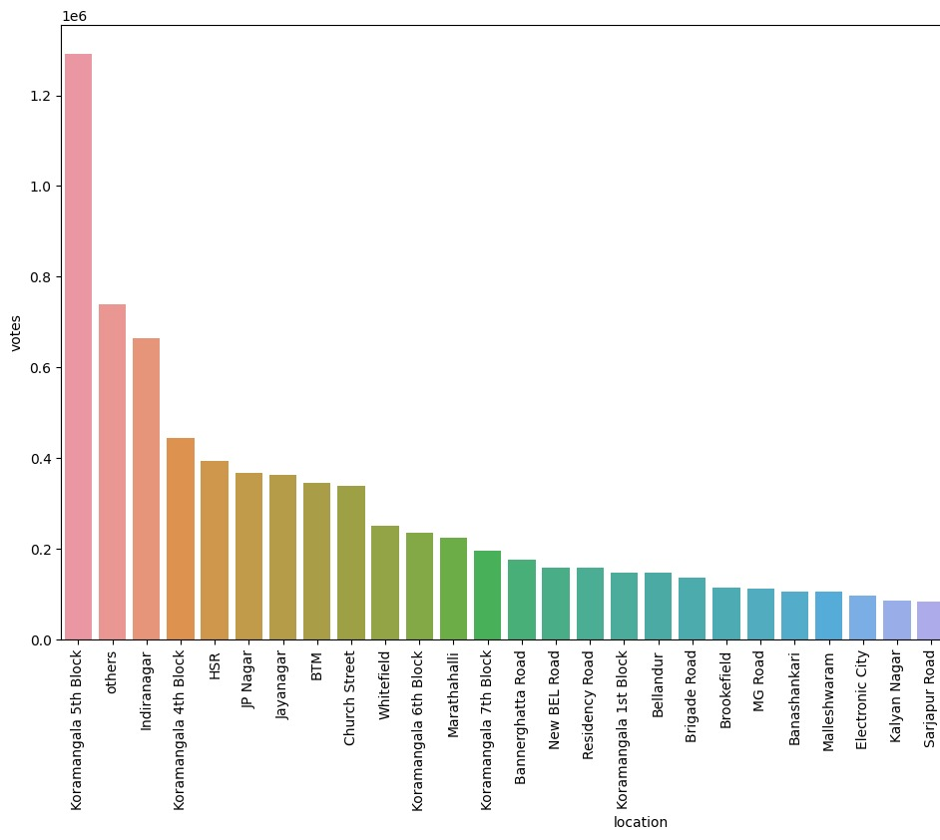
Location Wise Voting
Koramangala 5th block has garnered a significant number of votes, indicating strong engagement and participation from customers in this particular area.
Let us see from the graph to know that Koramangala 5th block has received 12,90,425 votes.

Slide 14
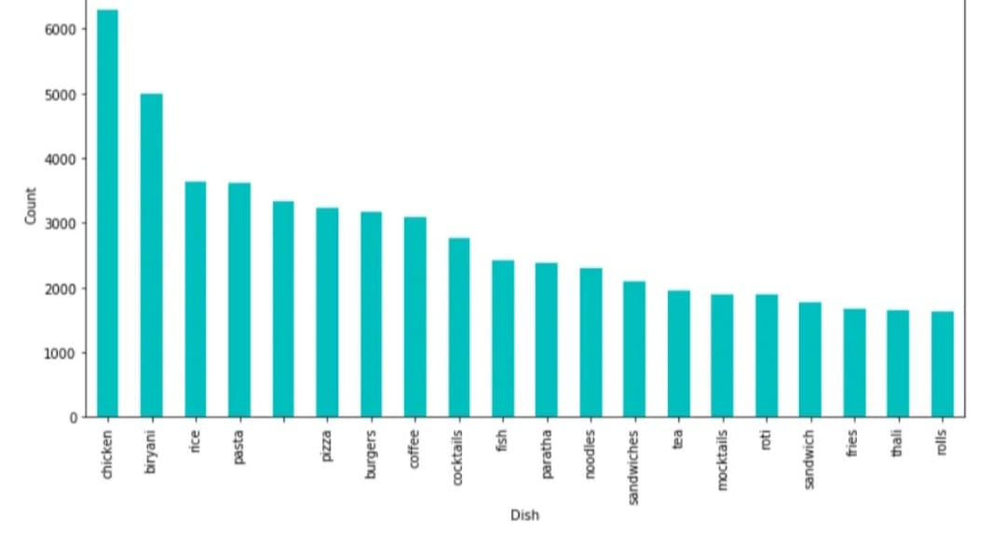
Dish Types
Dishes such Pasta, Burgers, Pizza, Biryani, Sandwiches, paratha and so on. Let us see from the graph to know, Most of them are like to eat Chicken nearly the count is 6500.

Slide 15
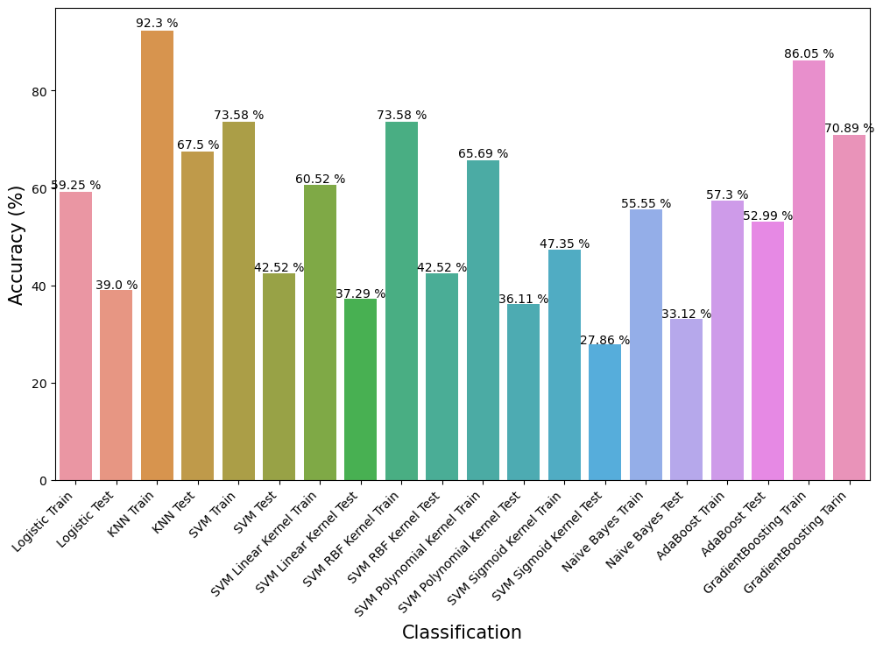
Build Machine Learning Multiple Models

Slide 16
Key Finding
Then, I utilized label encoding to transform the categorical columns into numerical format.
Koramangala 5th block has garnered a significant number of votes, indicating strong engagement and participation from customers in this particular location.
Afterward, I split the data into training and testing sets to build and evaluate the machine learning model.
Highest concentration of restaurants in "BTM“ and lowest in "DOMLUR”.
Popularity of Pubs and Bars, Buffet, and Drinks & Nightlife Higher ratings.

Slide 17
BUILD THE MACHINE LEARNING MODELS
The Extreme Gradient Boosting(XGB) model achieved an accuracy of 99.84% on the training data and 93.74% on the test data.
The Decision Tree model yielded high accuracy levels with 99.72% on the training data and 93.28% on the test data.
The Random Forest model obtained respectable accuracies of 99.72% on the training data and 94.69% on the test data.

Slide 18
Helpful For Business
In Bangalore ,it has more than 12,000 Restaurants ,Serving different dishes from all over the City. New Restaurants opening each and every day.
Analyze popular cuisines, trending dishes, and customer reviews to understand market preferences.
Identify areas with high demand or gaps in the market to optimize the location of your business.
Use data on popular dishes and cuisines to optimize your menu based on customer preferences.
Respond to customer reviews to build a positive online reputation and engage with your customer base.
There is a separate team for advertisement, which sells the website to the restaurant owners and attracts then to advertise with Zomato.

Slide 19
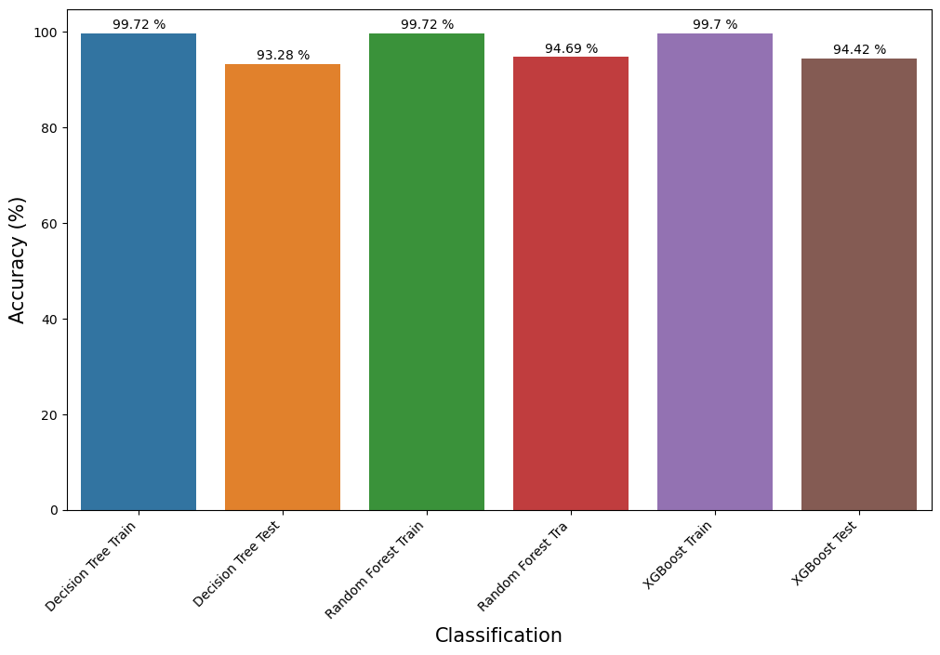
Conclusion
The random forest model provides the best accuracy results, with a high testing accuracy of 94.69%.
This suggests that the random forest model is more likely to perform well on new, unseen data and is the most suitable choice among the three models for this specific problem.

Slide 20
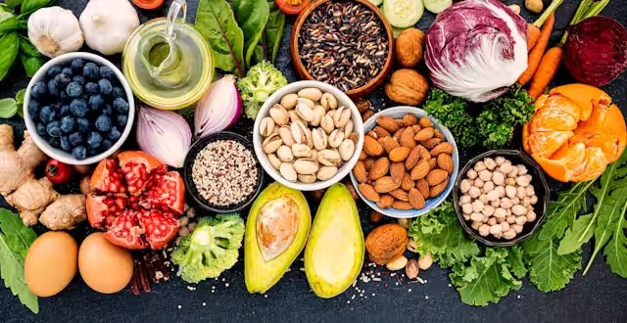
Thank You
Improve your mood by eating healthy food

